Slide 1

Methods and models for multivariate data analysis Coursework presentation
Students:
Victor Voronin, J41321c
Andrey Antonov, J41332c
Daniil Nelybin, J41325c
Notes:
Good day dear collegs. Our dream team are glad to present out course project.

Slide 2


Variables | Type
ArrDelay | continuous
Month | discrete
Day of Month | discrete
Dep Time | continuous
CRS Elapsed Time | continuous
Carrier Delay | continuous
Weather Delay | continuous
NAS Delay | continuous
Security Delay | continuous
Late Aircraft Delay | continuous
Dep Delay | continuous
TaxiIn | continuous
Taxi Out | continuous
Actual Elapsed Time | continuous
Notes:
Our conversation will be about delays in airlines and factors which influence to it. Dataset has 30 columns and we chose some of them for our project.

Slide 3
Lab 1
2
Analysis of univariate random variables

Slide 4
Target variables and predictors
3
Variable | Description | Type
Arr Delay | arrival delay | Continuous
Dep Delay | departure delay | Continuous
TaxiIn | taxi time from wheels down to arrival at the gate | Continuous
Taxi Out | taxi time from departure from the gate to wheels up | Continuous
Actual Elapsed Time | actual elapsed time of the flight | Continuous
Notes:
For this lab we selected follow variable. All of them are continuous.

Slide 5
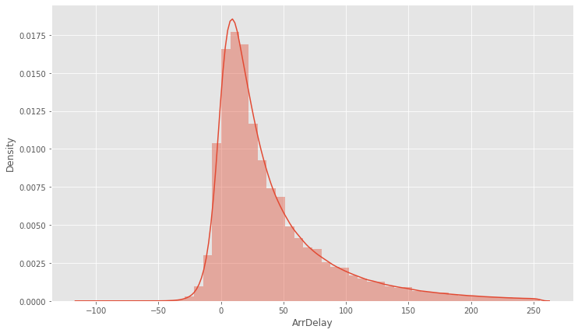
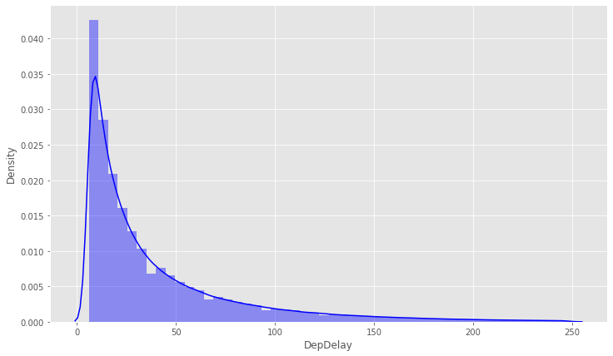
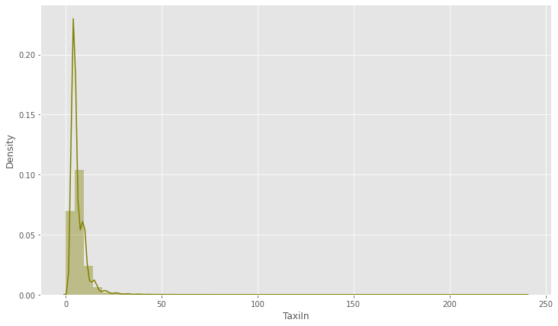
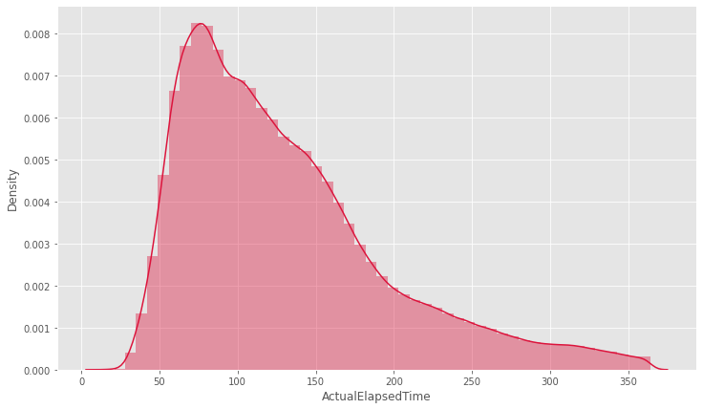
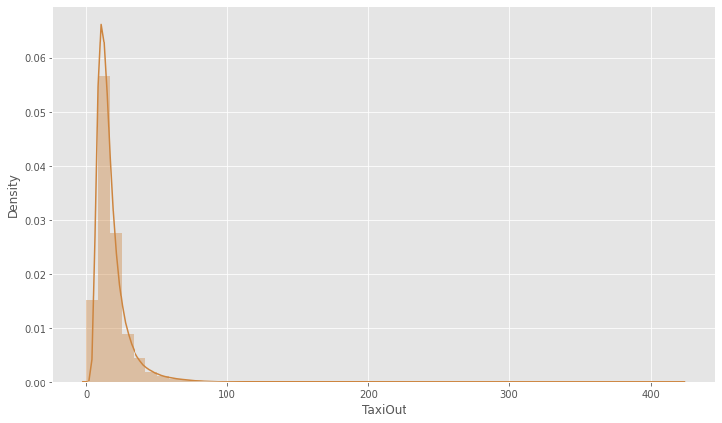
Non-parametric estimation of PDF
4
Notes:
With sns.distplot and kernel density function we have performed estimation for chosen variables.

Slide 6
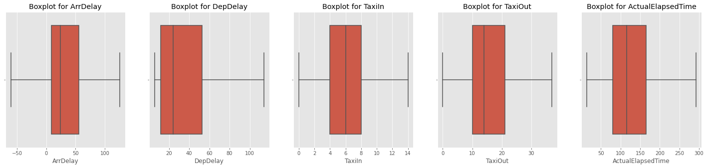
Estimation of order statistics
5
Variable | min | mean | max
ArrDelay | -109.0 | 24.0 | 266.0
DepDelay | 6.0 | 24.0 | 267.0
TaxiIn | 0.0 | 6.0 | 240.0
TaxiOut | 0.0 | 14.0 | 243.0
ActualElapsedTime | 14.0 | 116.0 | 1114.0
Notes:
Next step was draw boxplot and we see that there are not any outliers.

Slide 7
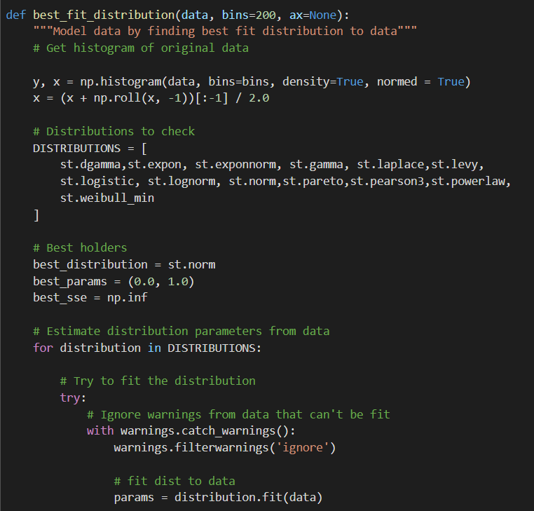
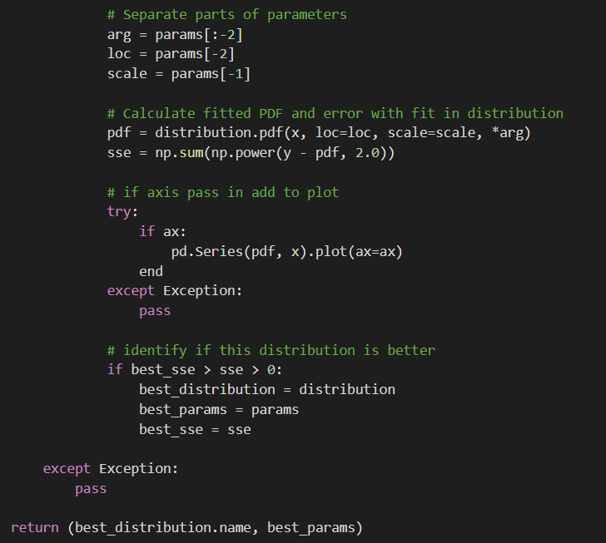
Best_fit_distribution
6
Notes:
Method best_fit_distribution selects the best in the MLE sense theoretical distribution for observed series from a given set. The method returns the name of the best fit distribution and its parameters. The parameters are estimated with attribute “.fit” in scipy.stats.rv_continuous.fit.
For implementation of least square method, we use scipy.optimize.curve_fit.

Slide 8
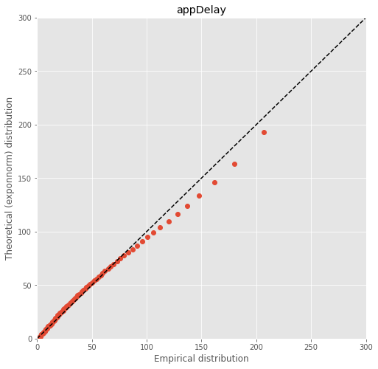
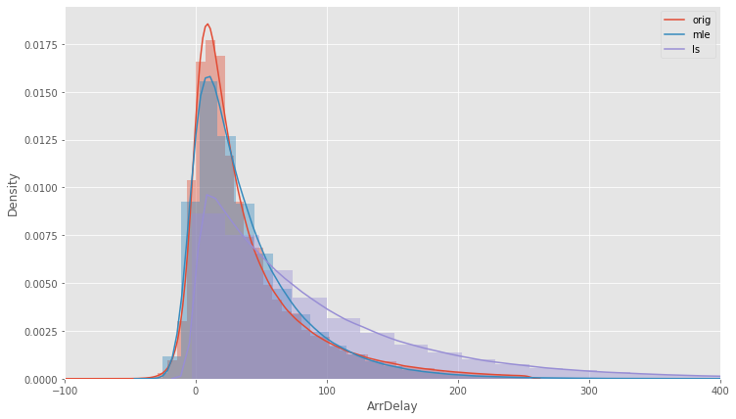
ArrDelay
7
Null hypothesis | Test | Statistical | Pvalue | Conclusion
ArrDelay described by exponnorm distribution | Kolmogorov-Smirnov | 0.044993 | 0.981982 | do not reject the null hypothesis
 | Cramér-von Mises | 0.041901 | 0.924031 | do not reject the null hypothesis
Notes:
Next slides will show plot of fitted distribution with both method. Here we see, pdf of ArrDelay with parameters from mle ‒ blue line, and least square method ‒ purple line. QQ-plot in right side of slide shows the closeness of the theoretical and observed distribution and it is also confirmed with statistical tests

Slide 9
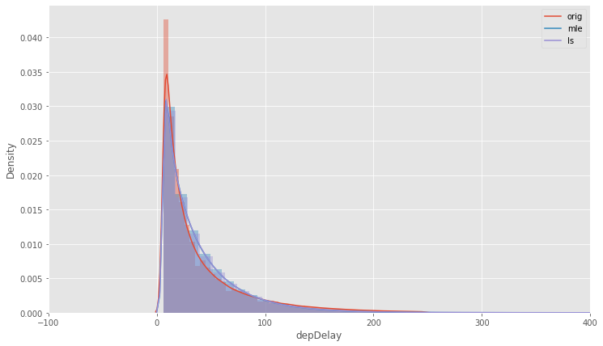
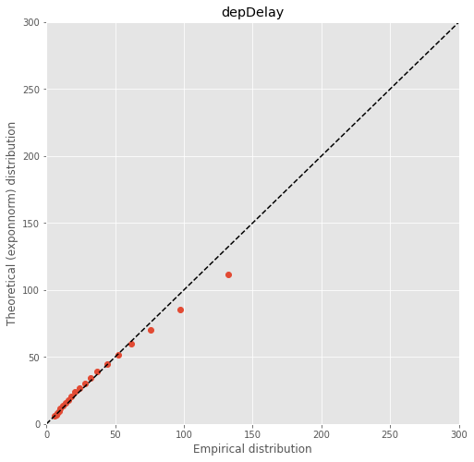
DepDelay
8
Null hypothesis | Test | Statistical | Pvalue | Conclusion
DepDelay described by gamma distribution | Kolmogorov-Smirnov | 0.08444 | 0.995138 | do not reject the null hypothesis
 | Cramér-von Mises | 0.035604 | 0.957899 | do not reject the null hypothesis

Slide 10
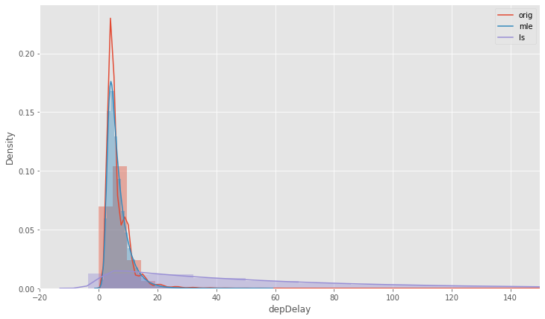
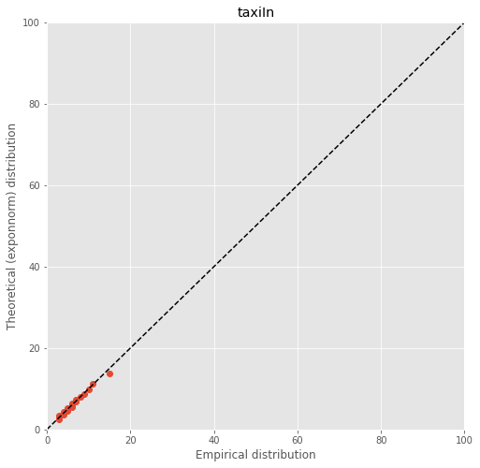
TaxiIn
9
Null hypothesis | Test | Statistical | Pvalue | Conclusion
taxiIn described by exponnorm distribution | Kolmogorov-Smirnov | 0.090159 | 0.989473 | do not reject the null hypothesis
 | Cramér-von Mises | 0.028307 | 0.983621 | do not reject the null hypothesis

Slide 11
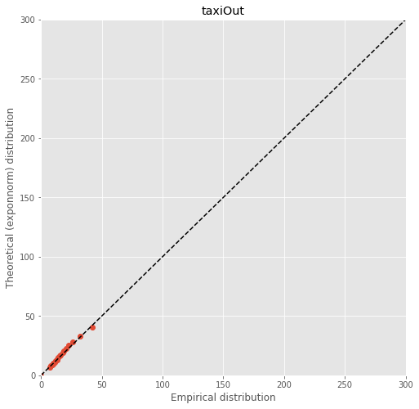
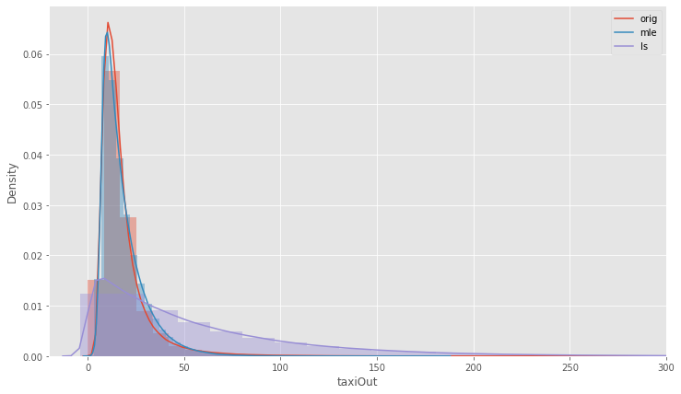
TaxiOut
10
Null hypothesis | Test | Statistical | Pvalue | Conclusion
taxiOut described by exponnorm distribution | Kolmogorov-Smirnov | 0.073737 | 0.99931 | do not reject the null hypothesis
 | Cramér-von Mises | 0.02132 | 0.99649 | do not reject the null hypothesis
Notes:
It is quite expected that TaxiIn and TaxiOut have the same distribution. It because there is strict procedure for flight crew and all what could have gone wrong it would have to finish on the previous stages. The return of the airplane from taxiing or run-up is costly to the reputation of the company everyone try to avoid this situation

Slide 12
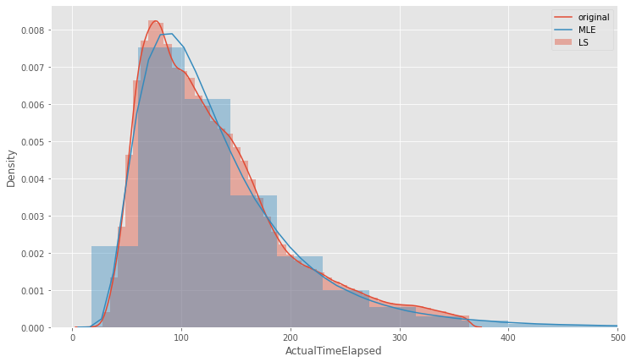
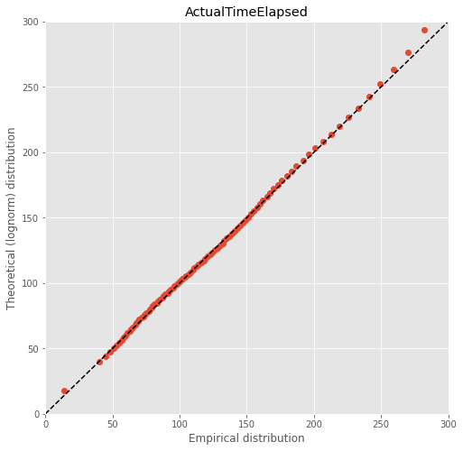
ActualElapsedTime
11
Null hypothesis | Test | Statistical | Pvalue | Conclusion
ActualTime described by lognorm distribution | Kolmogorov-Smirnov | 0.028464 | 0.999991 | do not reject the null hypothesis
 | Cramér-von Mises | 0.009865 | 0.999995 | do not reject the null hypothesis
Notes:
There are two strategies for planning the route grid in the world. Point-to-point and hub ones. The first one is characterized by many short, direct routes. Very convenient for passengers, very ruinous for airlines. Hub strategy implies the existence of large airports through which almost all flights go. This is the situation like in Russia with Moscow's airports. The same strategy in USA and we can see the realization of that on the plot. Mean elapsed time 116 minutes per flight, that is about two hours, that is there are not many many short route, there are quite long route to nearest hub.
If we try to draw the same plot for Europe airlines we see that peak of the pdf lies to the left. Because Europe use direct route strategy. Someone can say “it’s just because Europe is smaller!”. Yes, it’s true. that is why there is a direct route system. Being determines consciousness as Marx said.

Slide 13
Lab 2
12
Analysis of multivariate random variables

Slide 14
Target variables and predictors
13
Variable | Description | Type
ArrDelay | arrival delay | continuous
Month | month of the flight | discrete
DayofMonth | day of the month | discrete
DepTime | actual departure time | continuous
CRSElapsedTime | scheduled elapsed time of the flight | continuous
CarrierDelay | delay, in minutes, attributable to the carrier | continuous
WeatherDelay | delay, in minutes, attributable to weather factors | continuous
NASDelay | delay, in minutes, attributable to the National Aviation System | continuous
SecurityDelay | delay, in minutes, attributable to security factors | continuous
LateAircraftDelay | delay, in minutes, attributable to late-arriving aircraft | continuous

Slide 15
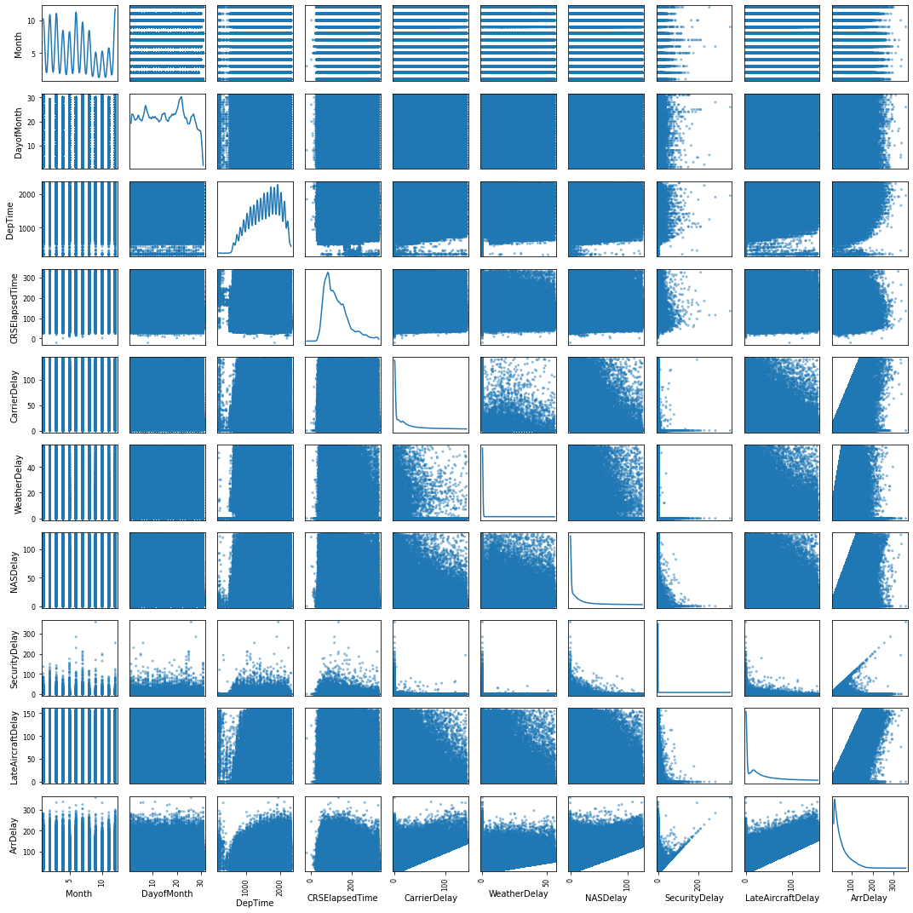
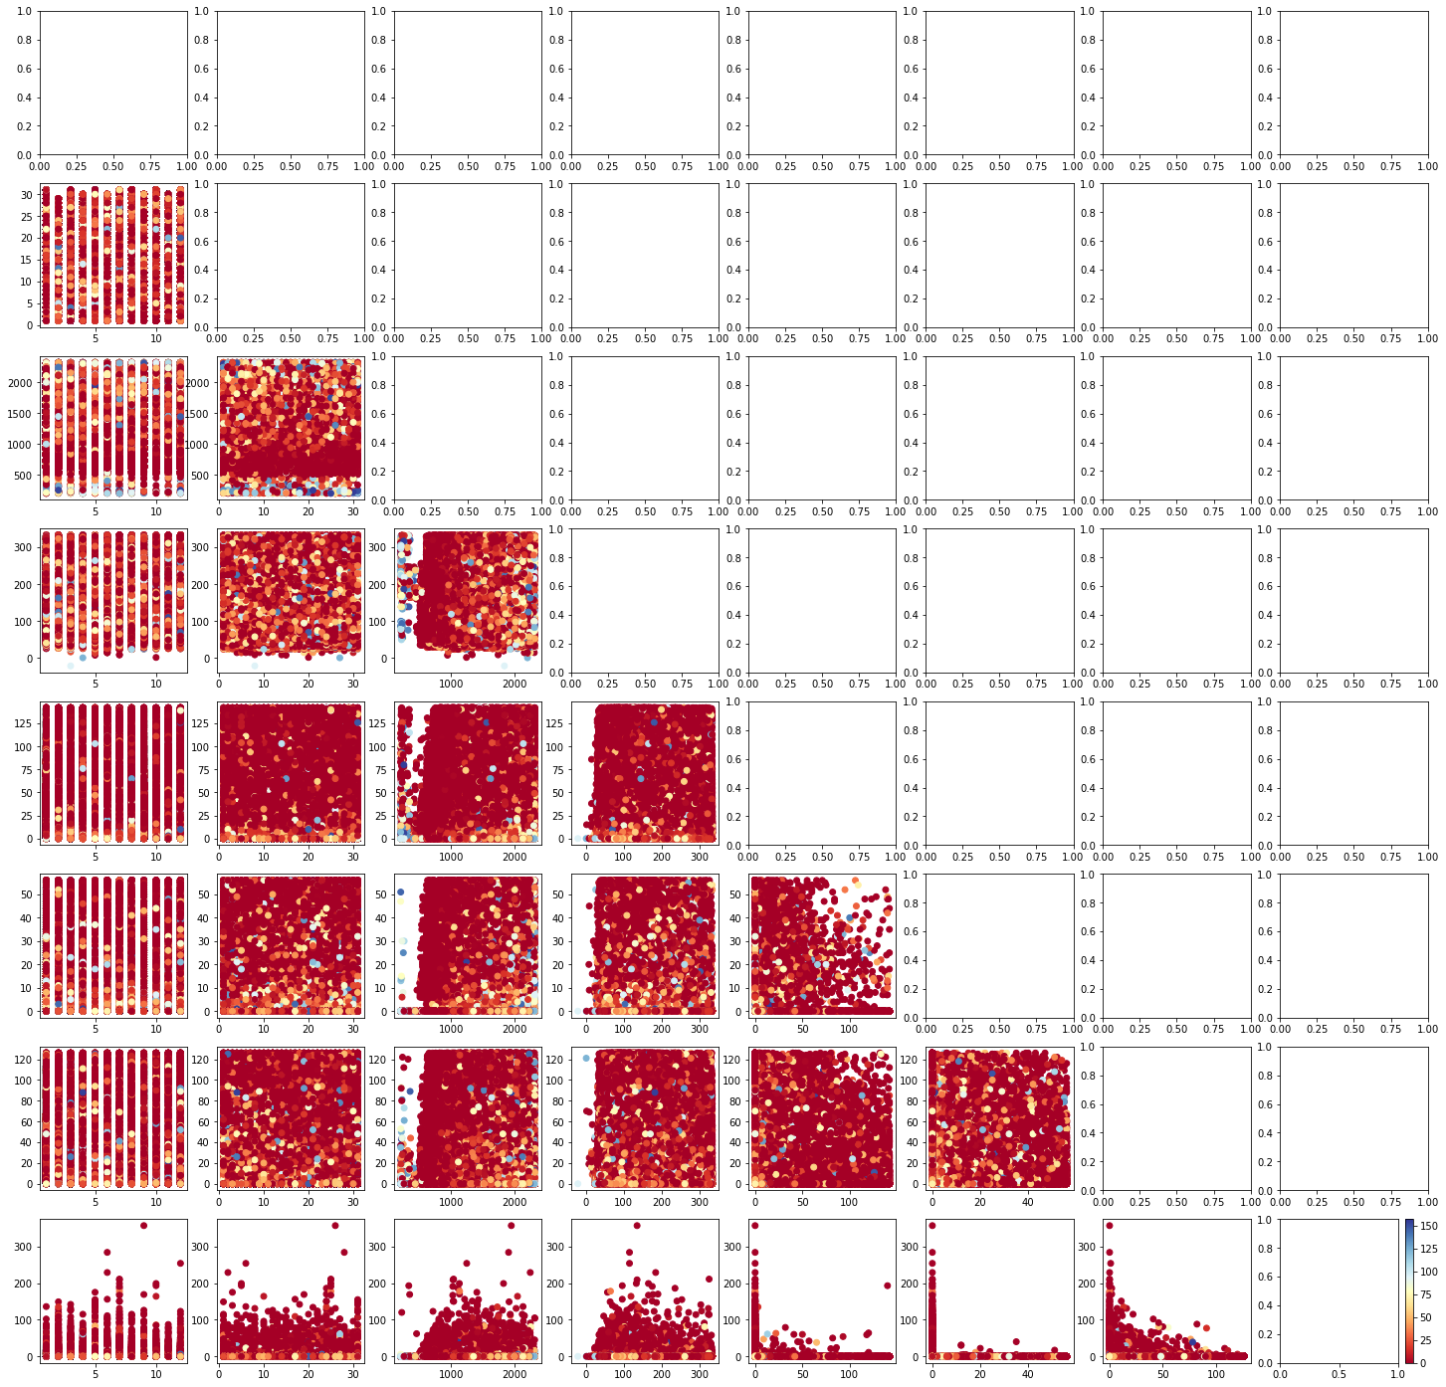
Non-parametric estimation of PDF MRV
14
Estimation of the MRV mean and variance
Variable | Mean | Variance
Month | 6 | 12
DayofMonth | 15 | 77
DepTime | 1558.832 (19:58:05) | 206415.606 (14:32:38)
CRSElapsedTime | 131.764 (18:20:10) | 4834.697 (16:43:41)
CarrierDelay | 19.179 | 1896.273
WeatherDelay | 3.703 | 461.886
NASDelay | 15.022 | 1144.676
SecurityDelay | 0.09 | 4.091
LateAircraftDelay | 25.296 | 1768.612
ArrDelay colorbar
Notes:
We try to predict arrive delay so we interesting to consider conditional distribution, mean and average under condition that arrive delay have become the certain value. To realize that at the first we choose from the dataset only the entries the predictor with the first value of arrive delay. Calculate mean and variance for obtained series. After that fix next value of arrive delay and choose from the dataset all values of a predictor with this value of target variable. Repeating this cycle, finally we have got the table with a number of rows that equal to a number of unique value in arrive delay and a number of columns that equal to a number of the predictors
On the left side of slide we see joint distribution for each pair variables with arrDelay colorbar. More cool color correspond bigger ArrDelay

Slide 16
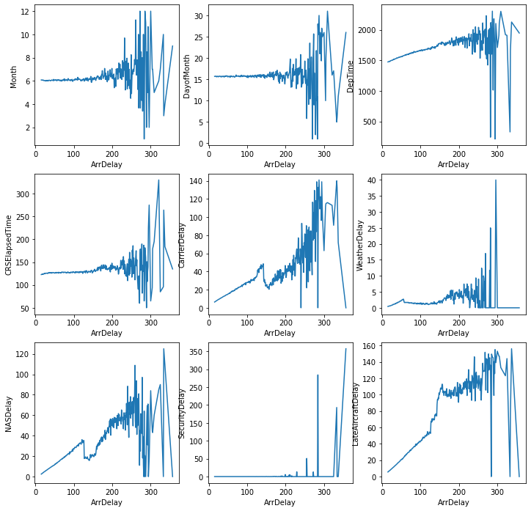
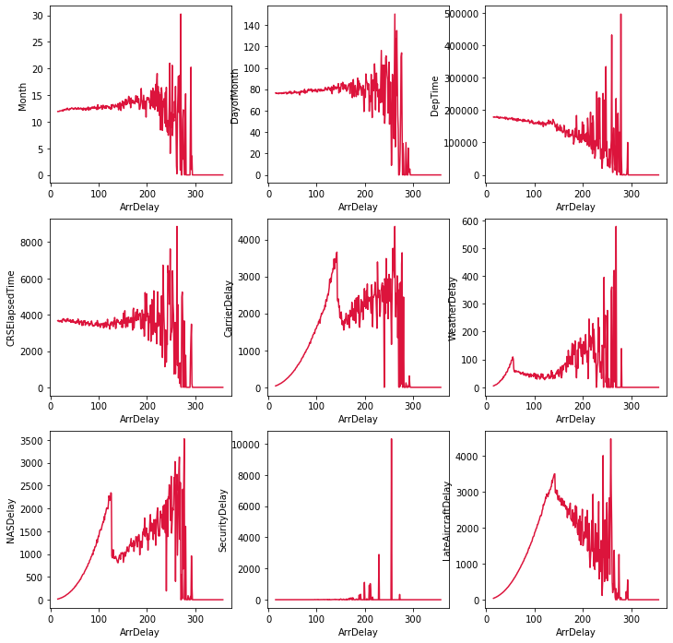
Conditional mean and variance
15
Conditional mean
Conditional variance

Slide 17
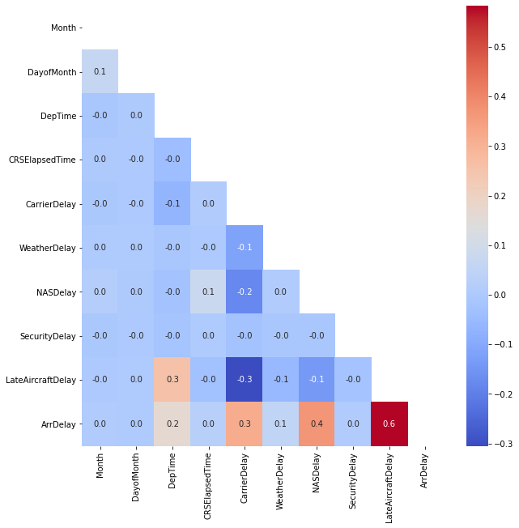
Multivariate correlation
16
Pair | p_value | Correlation | Conf. interval
Month – LateAircraftDelay | 0.326 | 0.001 | (-0.003; 0.001)
DayofMonth – CRSElapsedTime | 0.846 | 0.000001 | (-0.002; 0.002)
DayofMonth – CarrierDelay | 0.358 | 0.001 | (-0.003; 0.001)
DayofMonth – NASDelay | 0.72 | 0.000001 | (-0.002; 0.002)
DayofMonth – SecurityDelay | 0.374 | 0.001 | (-0.003; 0.001)
WeatherDelay – CRSElapsedTime | 0.059 | 0.002 | (-0.004; 0.0)
Notes:
Correlation is square matrix with a number of rows that equals to a number of a variables. In our case it is 10x10. Correlation matrix is symmetrical one in relate to the diagonal. So ,we create down-corner matrix mask and calculate correlation between all variables
As we can see from correlation matrix the significant correlation between in example ArrDelay and LateAircraftDelay. However, pvalue of these correlation coefficients is low. We have extracted every non-zero p-value from the last point and have got follow table
In other words, of course, we have come strong correlation between predictors, but they all are not statistically significant. Those who are such ones have near-zero correlation coefficient

Slide 18
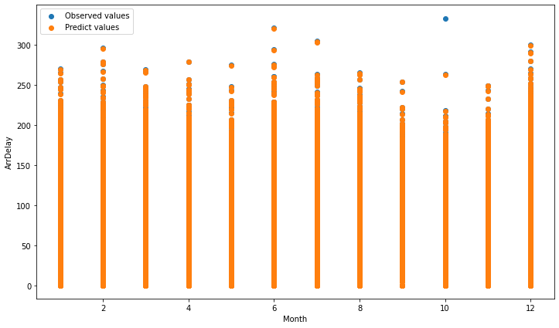
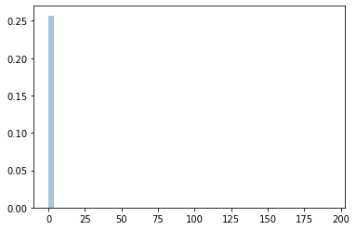
Linear Regression
17
Id | Month | DayofMonth | CarrierDelay | LateAircraftDelay | NASDelay | WeatherDelay | ArrDelay_pred | ArrDelay
379245 | 3 | 8 | 0.0 | 29.0 | 0.0 | 0.0 | 29.175600 | 29.0
1131391 | 7 | 23 | 125.0 | 0.0 | 6.0 | 0.0 | 130.757825 | 131.0
1217640 | 7 | 12 | 21.0 | 0.0 | 0.0 | 0.0 | 21.169990 | 21.0
239699 | 2 | 26 | 0.0 | 0.0 | 0.0 | 47.0 | 46.994852 | 47.0
278300 | 2 | 1 | 0.0 | 101.0 | 0.0 | 0.0 | 100.978162 | 101.0
Metrics | ArrDelay
RMSE | 2.015
MAPE | 0.007
R² | 0.997
Mean = 0.0031
Var = 4.414
Notes:
As we can see from correlation matrix there is weak linear dependencies between predictors. Thus, we don’t use penalties
We create train and test dataset with train_test_split and given test_size = 25% of all available data. Linear regression model was trained with train dataset and we got the predict had getting for test dataset.
Apart from that we can plot histogram test and predict target variable and in full agreement with metrics we see well result

Slide 19
Lab 3
18
Sampling of multivariate random variables

Slide 20
Target variables and predictors
19
Variable | Description | Type
ArrTime | Arrival time | continuous
DepTime | Departure time | continuous
CRSArrTime | Scheduled arrival time | continuous
CRSDepTime | Scheduled departure time | continuous
Distanse | Distance traveled | continuous
LateAircraftDelay | Aircraft delay | continuous
CarrierDelay | Carrier delay | continuous
ArrDelay (target) | Arrival delay | continuous
DepDelay (target) | Departure delay | continuous
ActualElapsedTime (target) | Actual elapsed time of the flight | continuous

Slide 21
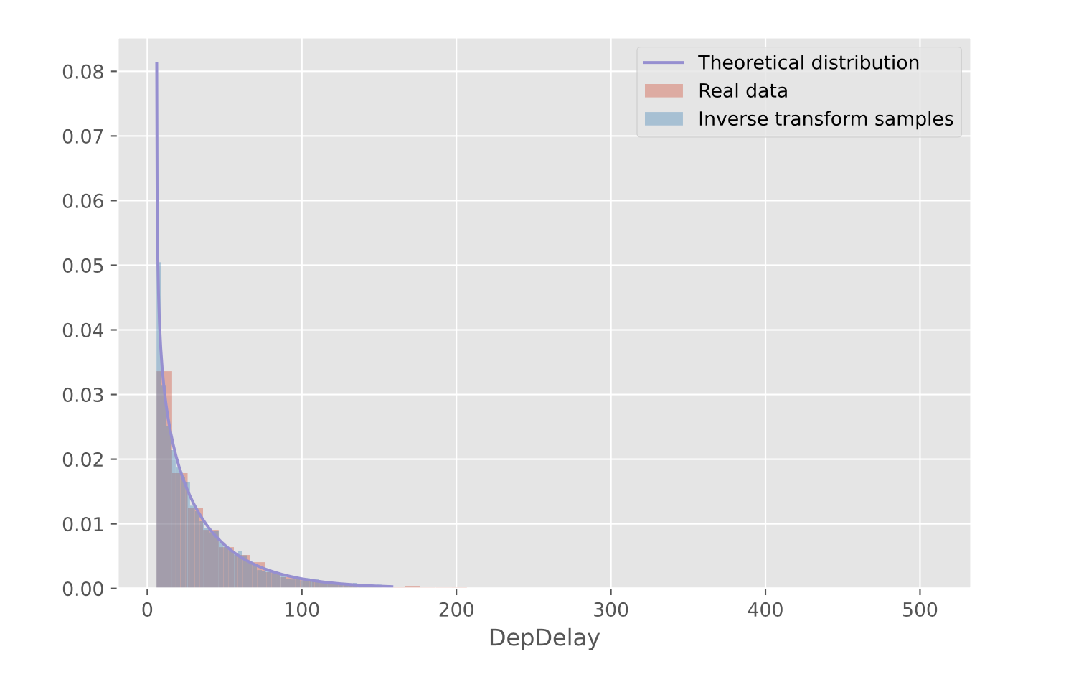
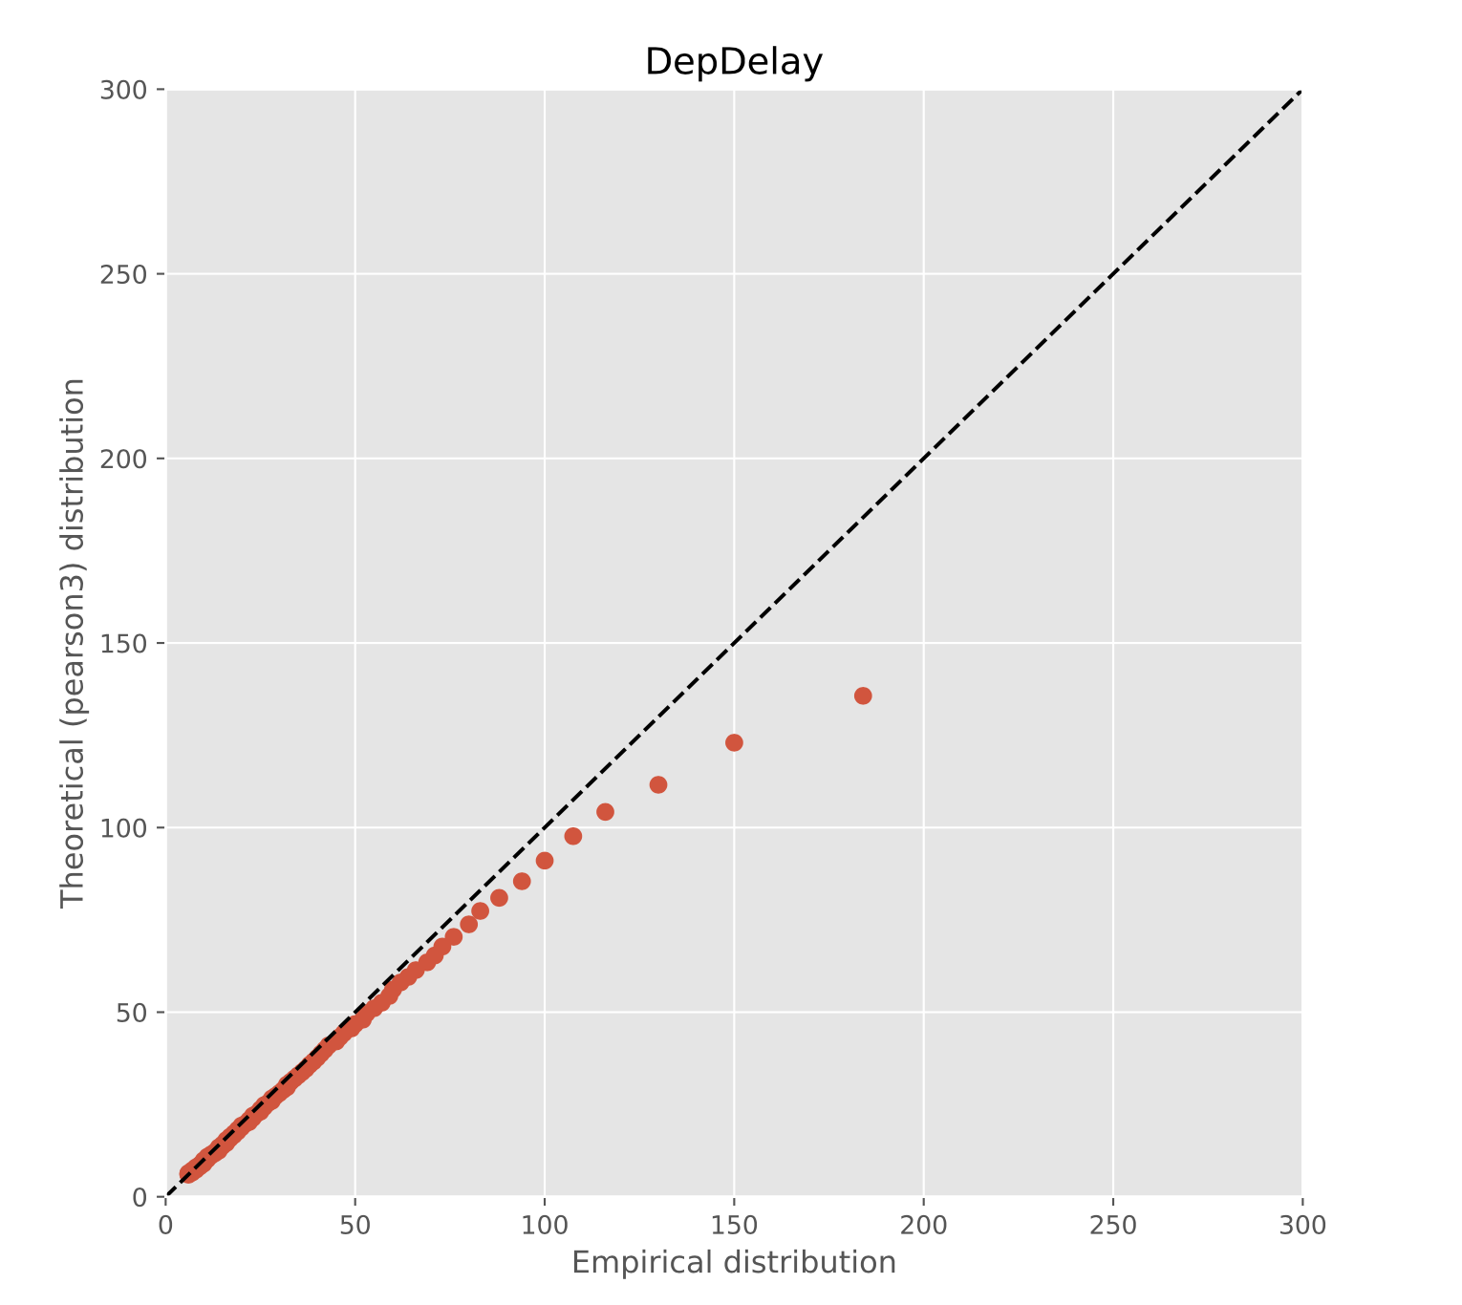
Inverse-transform sampling of DepDelay
20

Slide 22
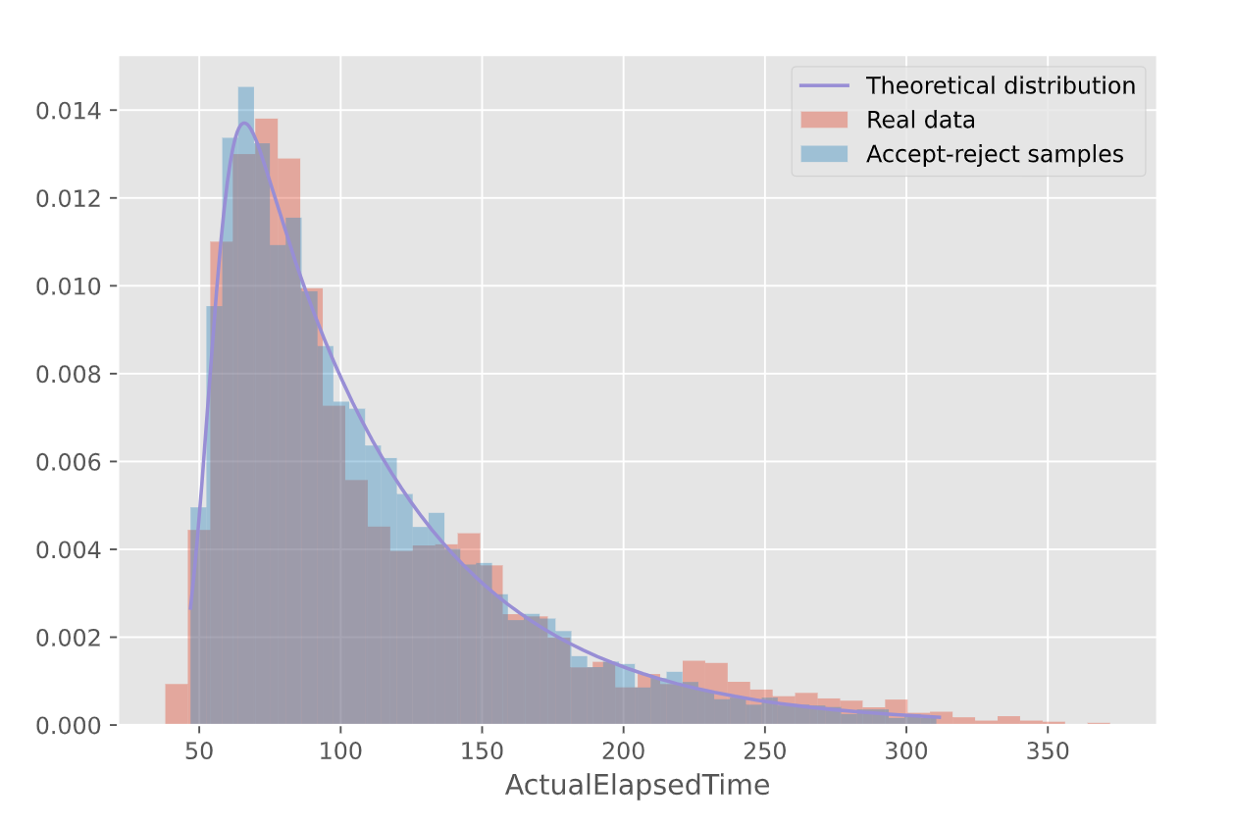
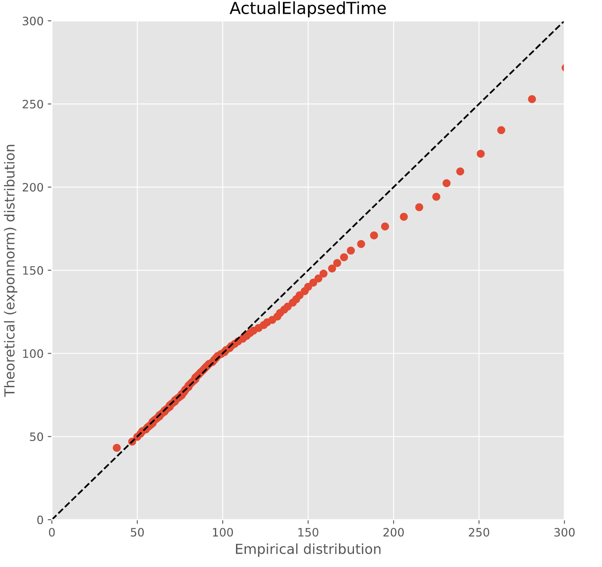
Accept-reject sampling of ActualElapcedTime
21

Slide 23
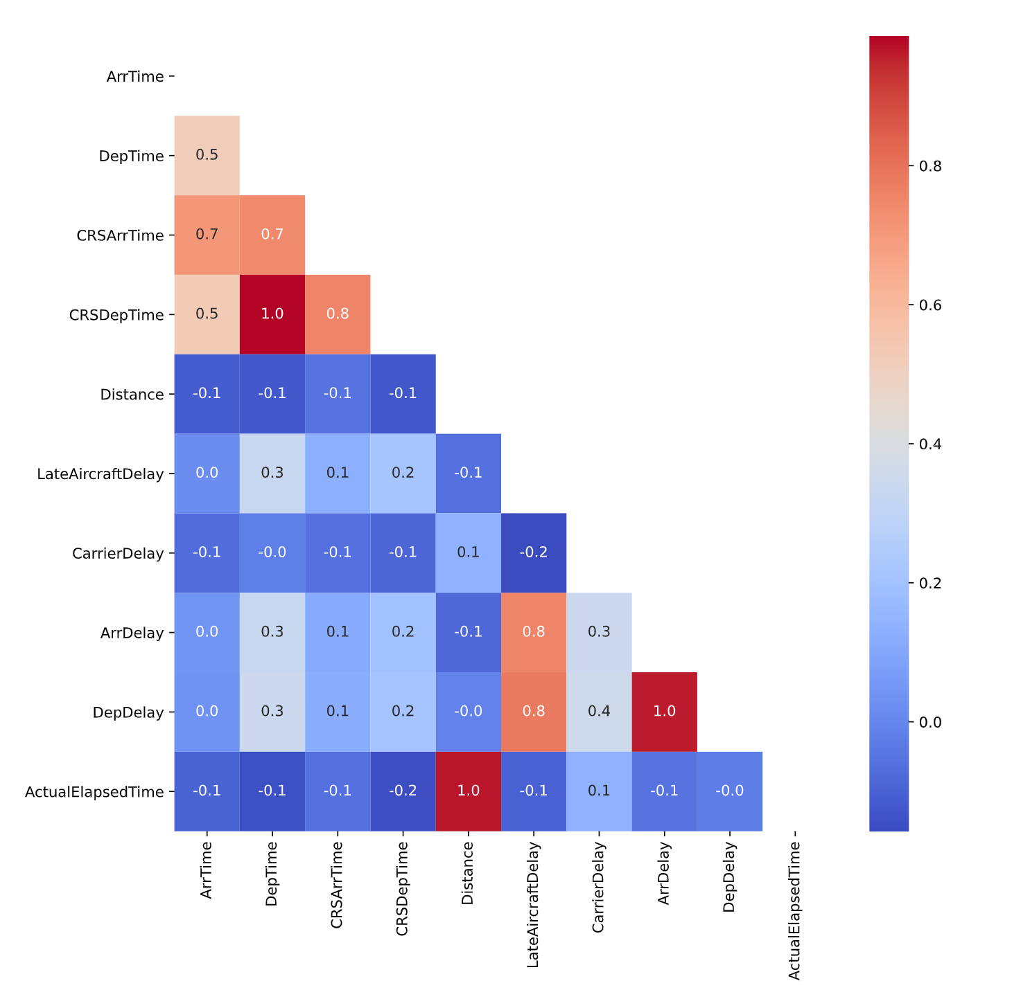
Correlation of the variables
22

Slide 24
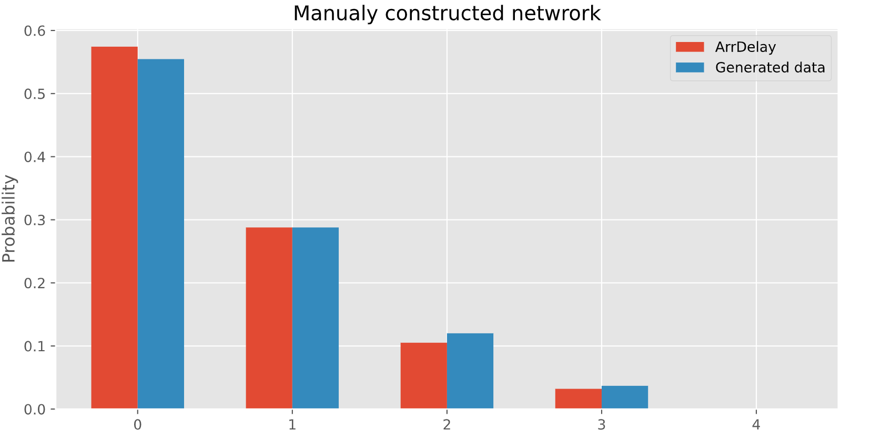
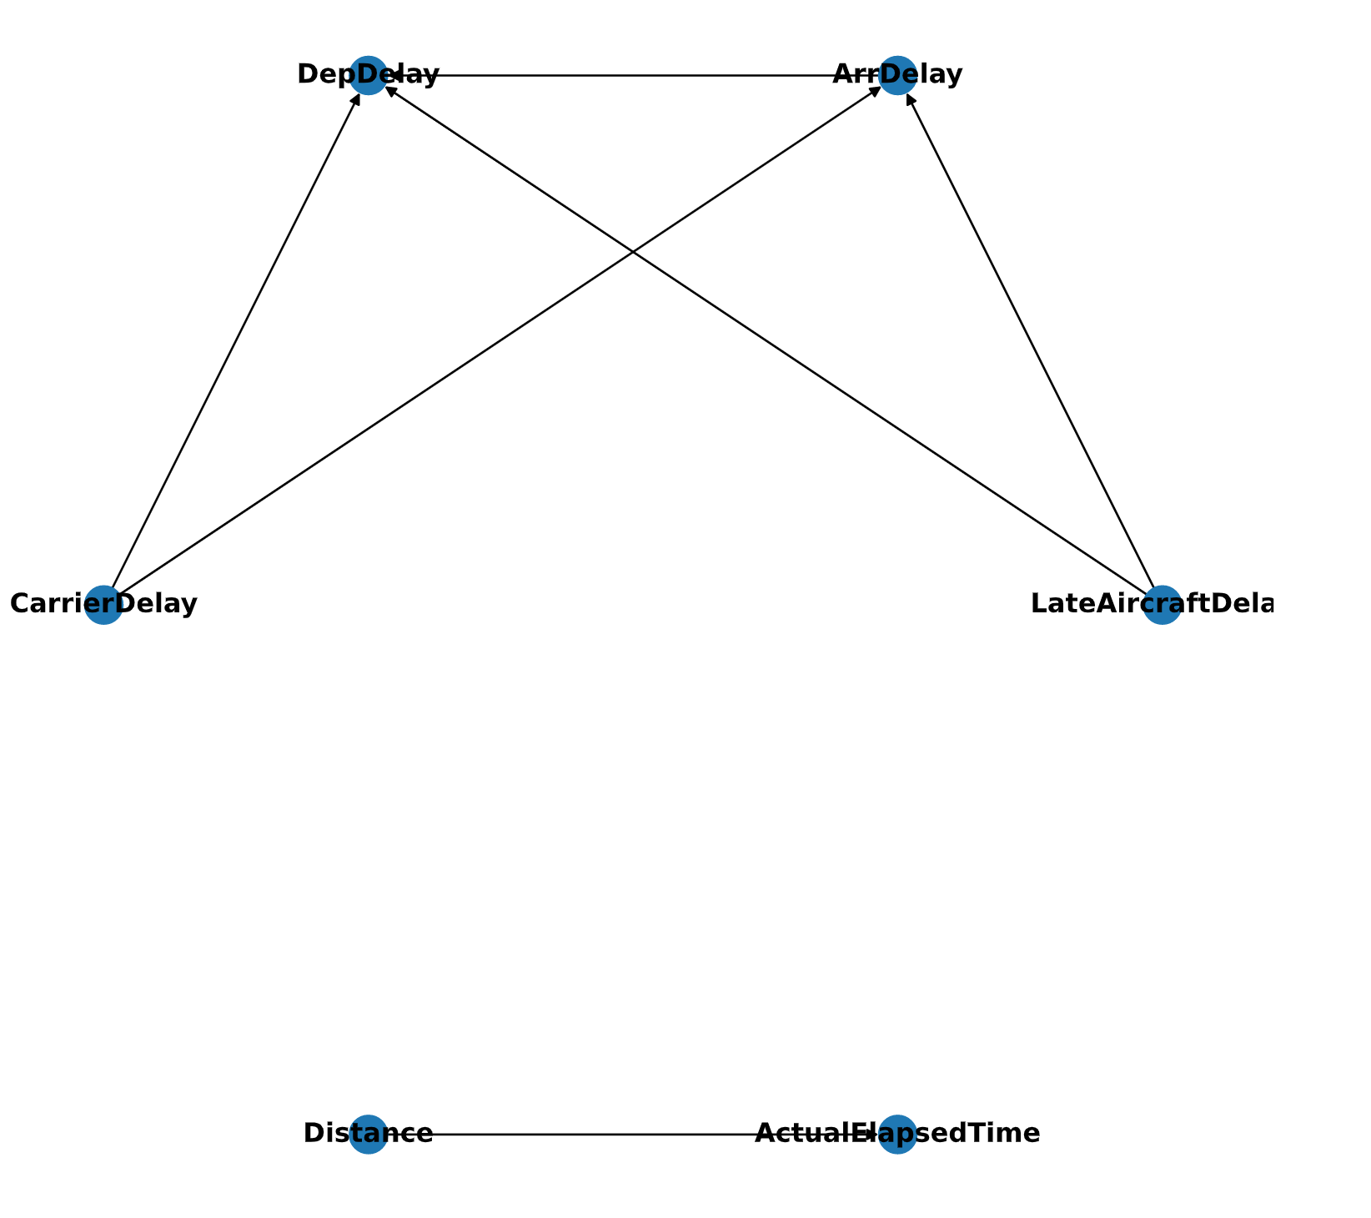
Manually constructed Bayesian network
23
Metrics | ArrDelay
RMSE | 29.20
MAE | 12.87
R² | 0.67

Slide 25
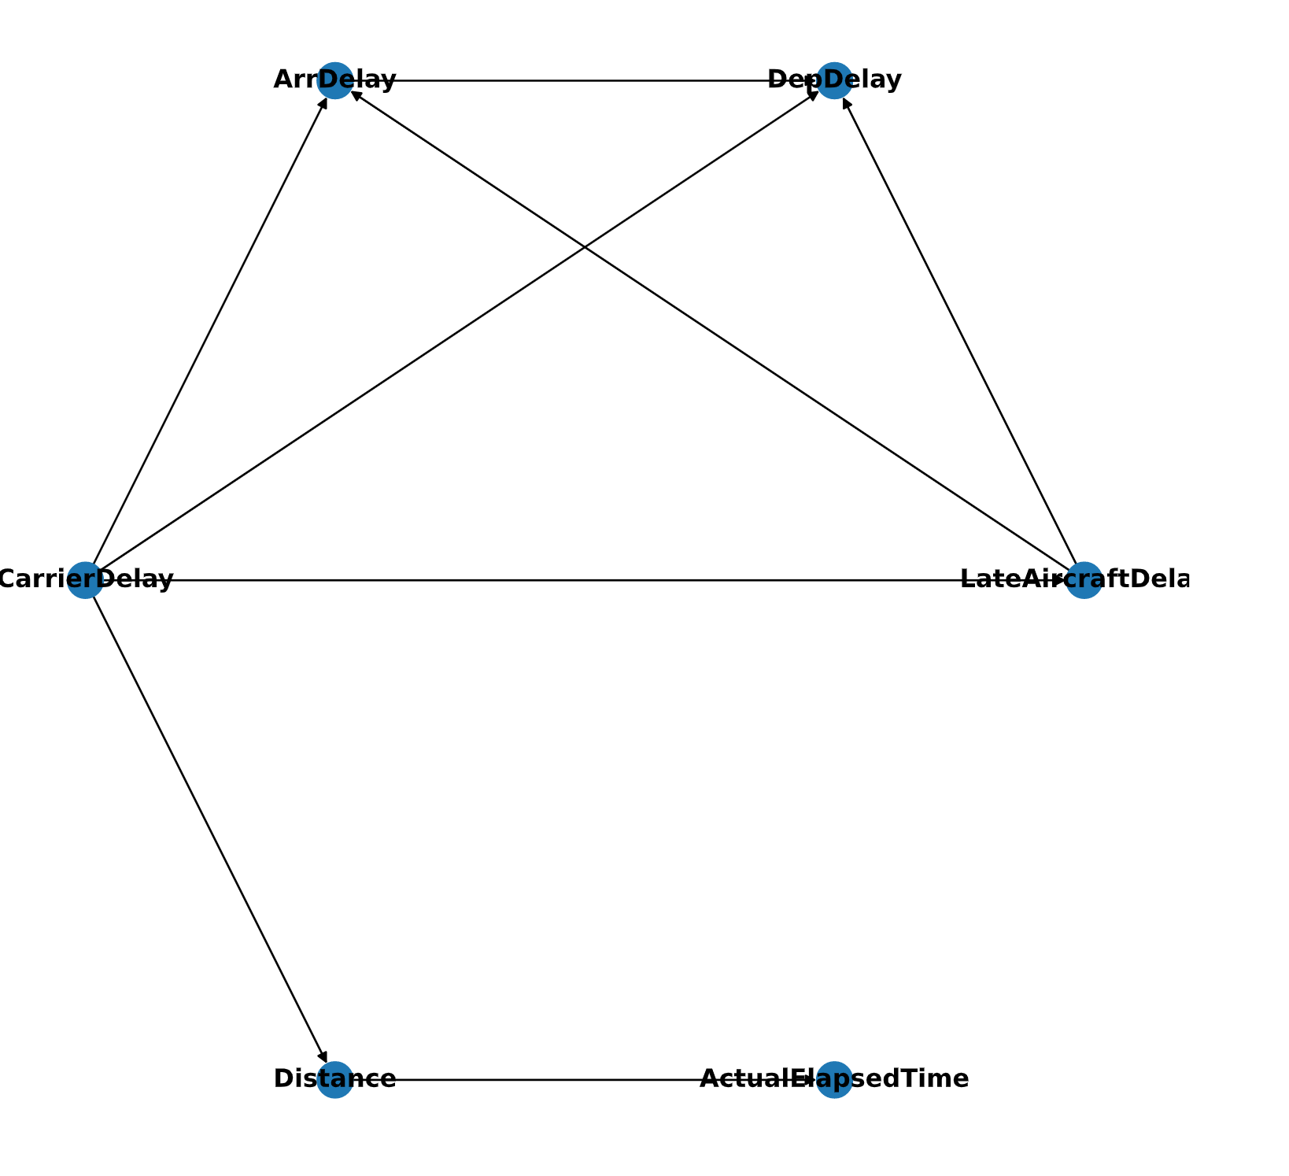
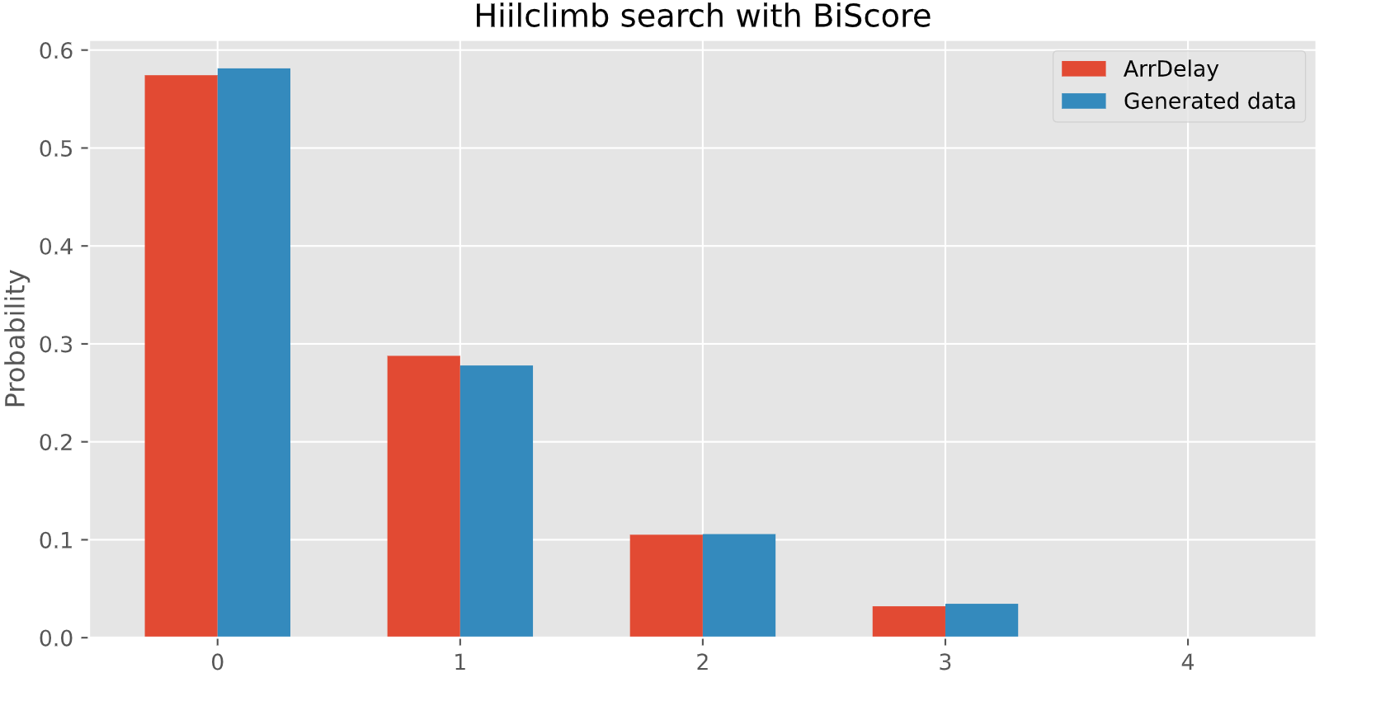
HillClimb Search Bayesian network
24
Metrics | ArrDelay
RMSE | 54.51
MAE | 23.76
R² | 0.88

Slide 26
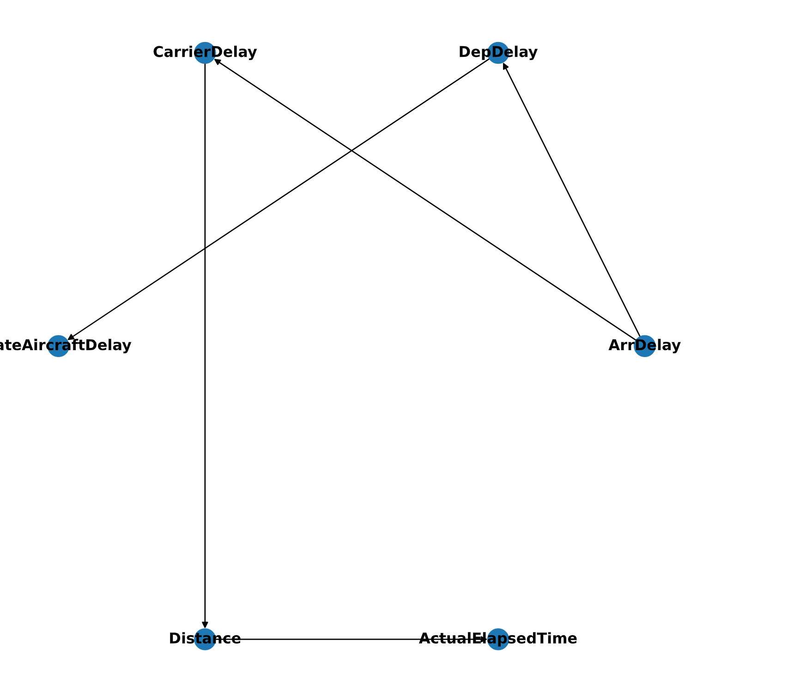

Tree search Bayesian network
25
Metrics | ArrDelay
RMSE | 58.87
MAE | 24.53
R² | 0.85

Slide 27
Lab 4
26
Stationarity of the processes

Slide 28
Predictors and target variables
27
Variable | Description | Type
Arr Delay | arrival delay | continuous
Month | month of the flight | discrete
Day of Month | day of the month | discrete
Dep Time | actual departure time | continuous
CRS Elapsed Time | scheduled elapsed time of the flight | continuous
Carrier Delay | delay, in minutes, attributable to the carrier | continuous
Weather Delay | delay, in minutes, attributable to weather factors | continuous
NAS Delay | delay, in minutes, attributable to the National Aviation System | continuous
Security Delay | delay, in minutes, attributable to security factors | continuous
Late Aircraft Delay | delay, in minutes, attributable to late-arriving aircraft | continuous
Notes:
Merge columns Month and DayofMonth into one column “Date” and choose the most frequency flight from the initial dataset. We try to predict ArrDelay for two most frequency flight

Slide 29
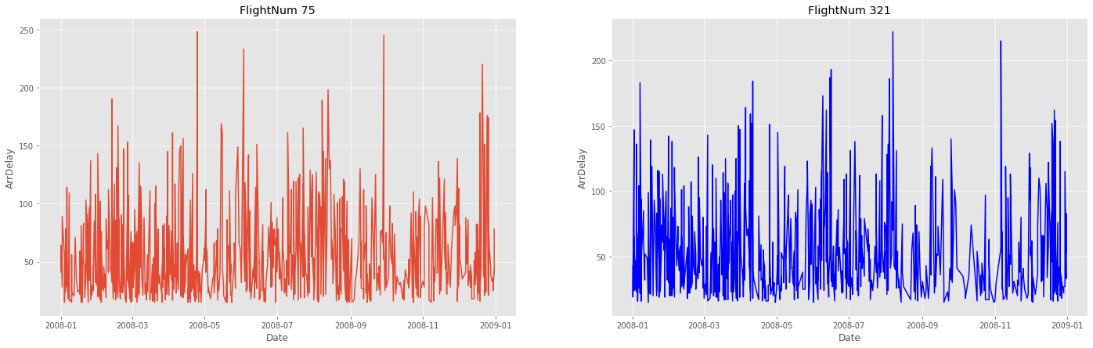
Analysis of stationarity
28
Variable | Statistical value | p-value | Conclusion
ArrDelay | -26.413199 | 0.1e-13 | stationary
DepTime | -14.900550 | 0.1e-8 | stationary
CRSElapsedTime | -28.915694 | 0.2e-6 | stationary
CarrierDelay | -22.915694 | 0.1e-7 | stationary
WeatherDelay | -29.242249 | 0.2e-5 | stationary
NASDelay | -19.131572 | 0.3e-13 | stationary
SecurityDelay | -28.819522 | 0.1e-8 | stationary
LateAircraftDelay | -27.852850 | 0.6e-6 | stationary
Notes:
Just see on the plots we could say that both time series are quite stationary, but to gain confidence we perform the Dickey - Fuller test and it confirm our expectations. All our variables are stationarity.

Slide 30
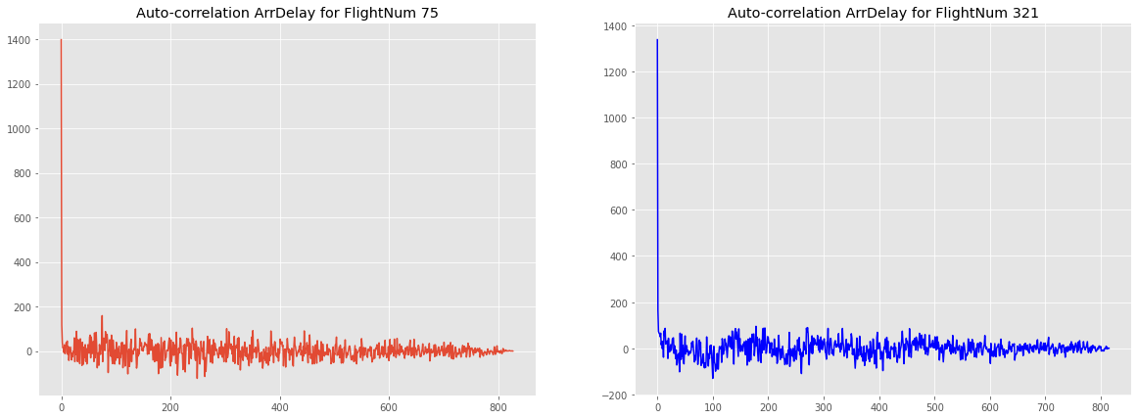
Auto-correlation for target variables
29

Slide 31
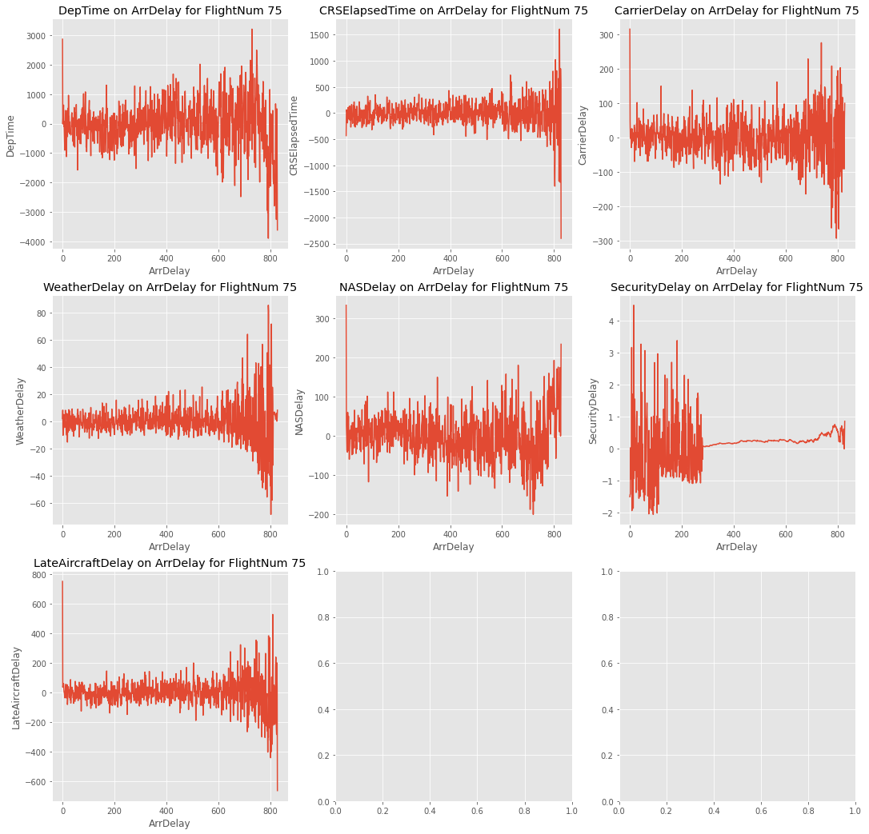
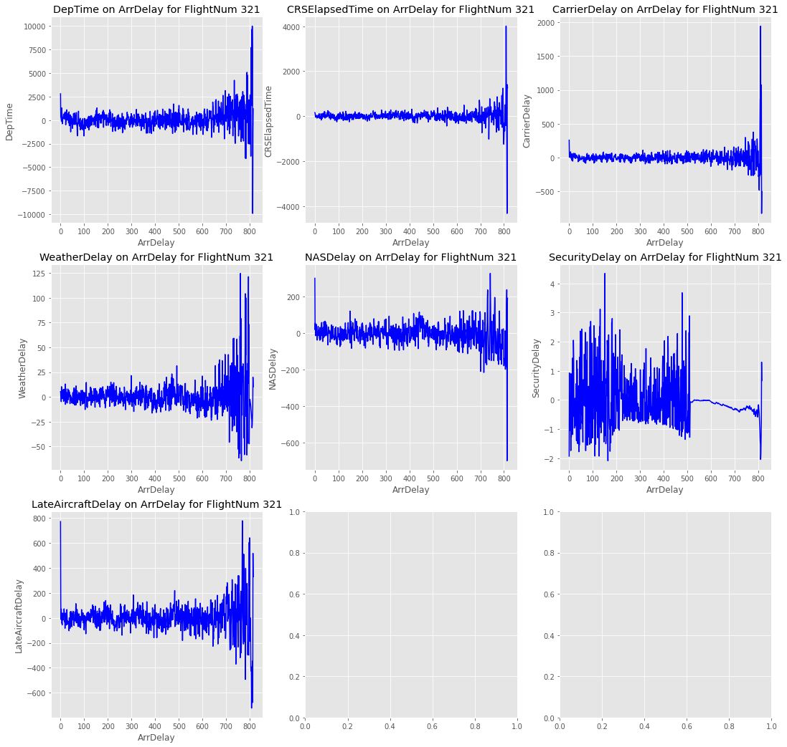
Correlation b\w target variables and predictors
29

Slide 32
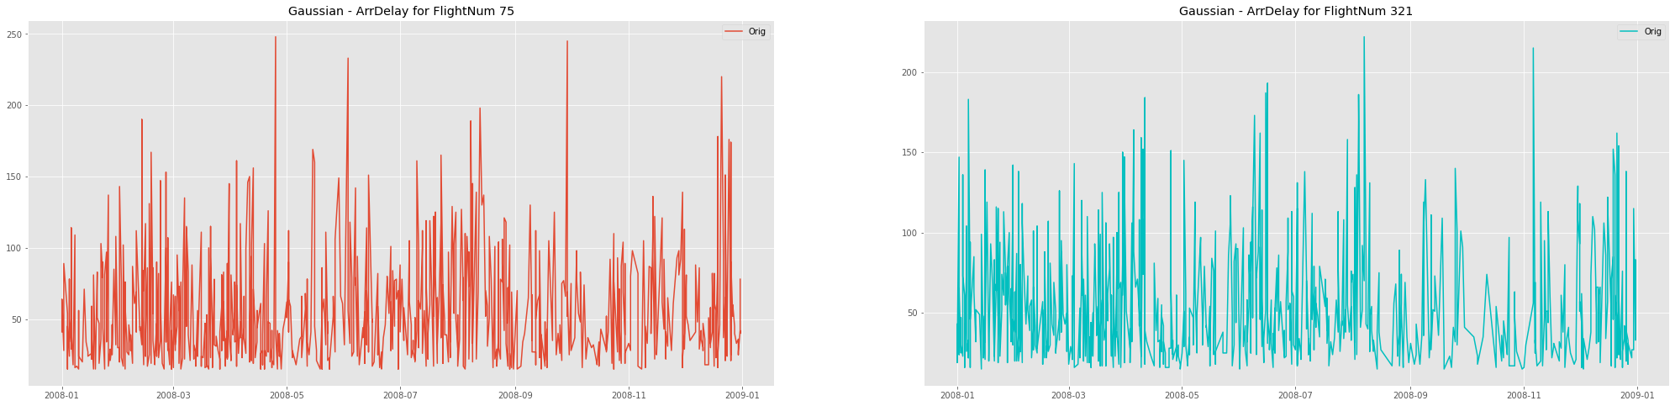
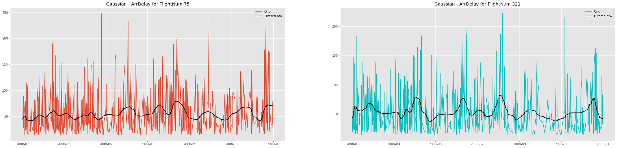
Butterworth filter
29
75
321
Notes:
Noise has been filtered with Butterworth. On the left side there is “before” state, and on the right side ‒ “after” state.

Slide 33
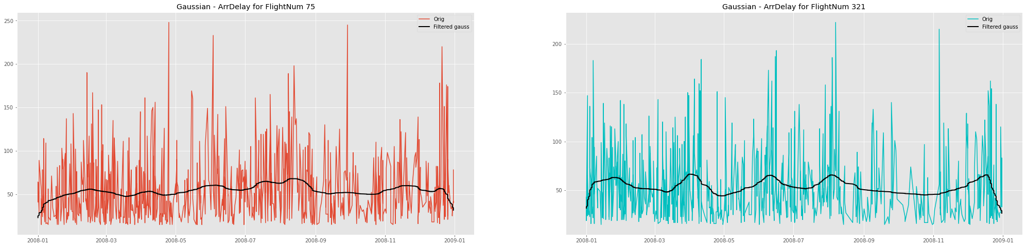
Gauss filter
30
75
321
Notes:
and the same operation with Gaussian filters

Slide 34
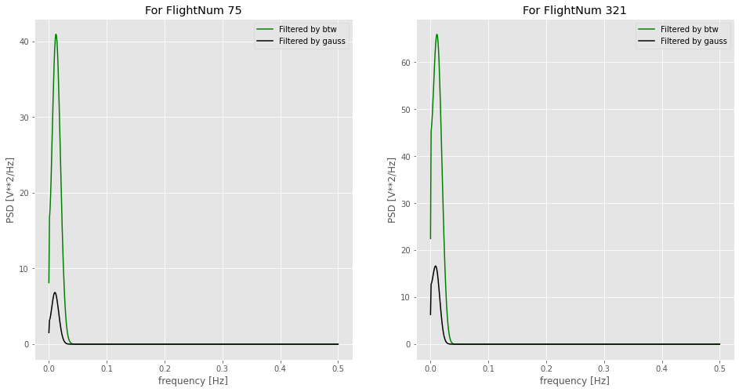
Spectral Density
31
Notes:
and the same operation with Gaussian filters

Slide 35
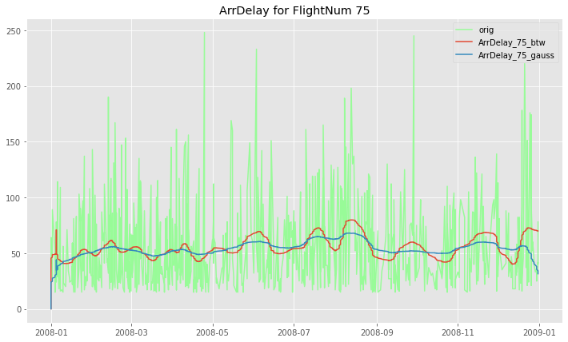
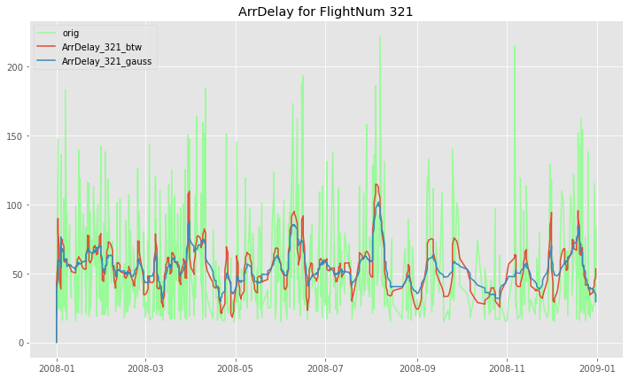
Auto-regression model
31
Series | Model | AIC
ArrDelay | SARIMAX(5, 1, 5)x(1, 1, 0, 12) | 8533.255
ArrDelay_75_btw | SARIMAX(5, 1, 5)x(1, 1, 0, 12) | 5681.599
ArrDelay_75_gauss | SARIMAX(5, 1, 5)x(1, 1, 0, 12) | 7430.193
ArrDelay_321_btw | SARIMAX(5, 1, 5)x(1, 1, 0, 12) | 5357.291
ArrDelay_321_gauss | SARIMAX(5, 1, 5)x(1, 1, 0, 12) | 7288.278
FlightNum | Filter | RMSE | R2
75 | None | 44.198 | -1.874
 | Butterworth filter | 1.81 | 0.959
 | Gauss filter | 0.89 | 0.983
321 | None | 43.091 | -1.793
 | Butterworth filter | 2.098 | 0.934
 | Gauss filter | 1.822 | 0. 978
Notes:
and the same operation with Gaussian filters

Slide 36
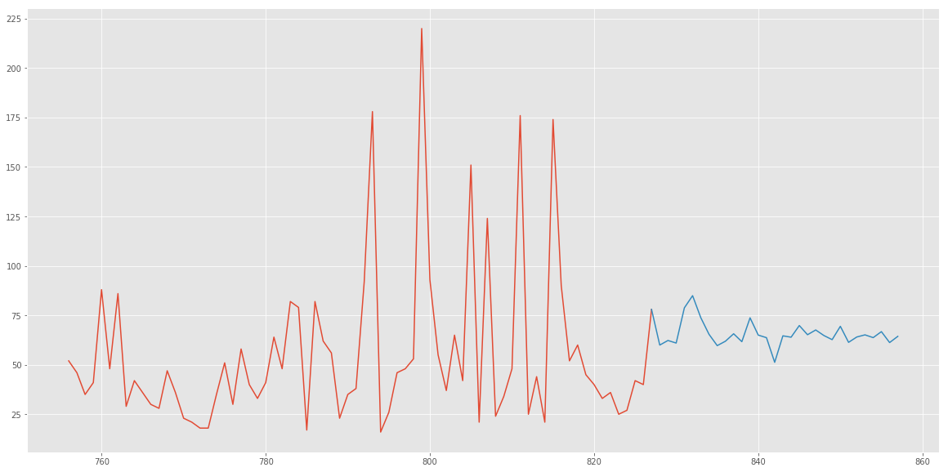
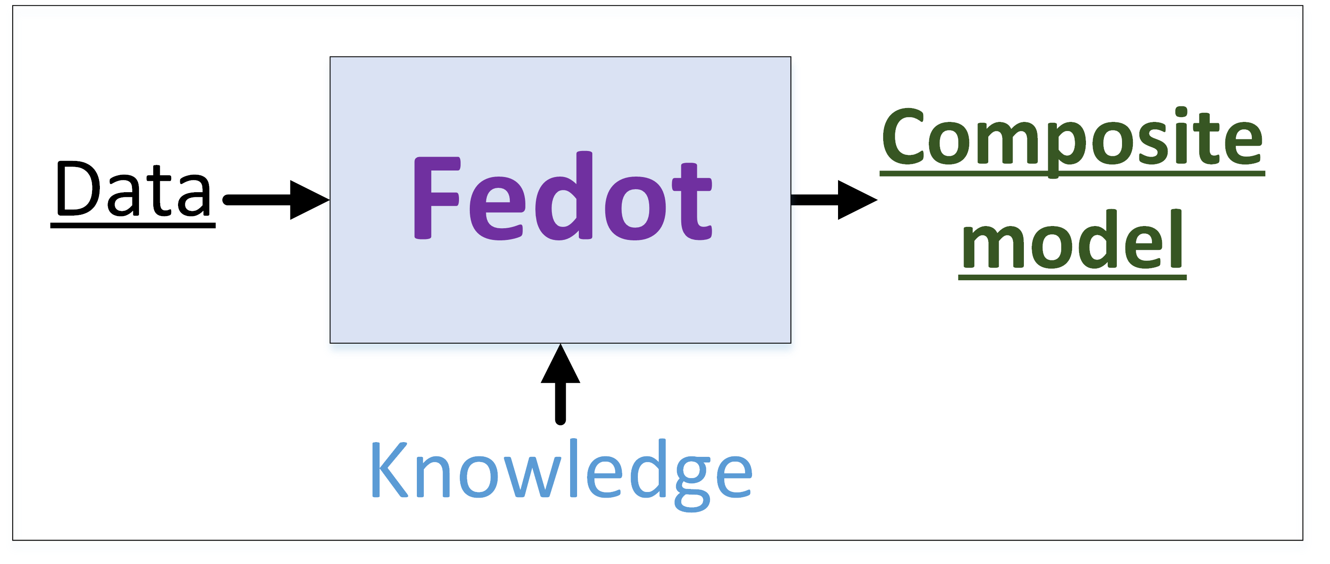
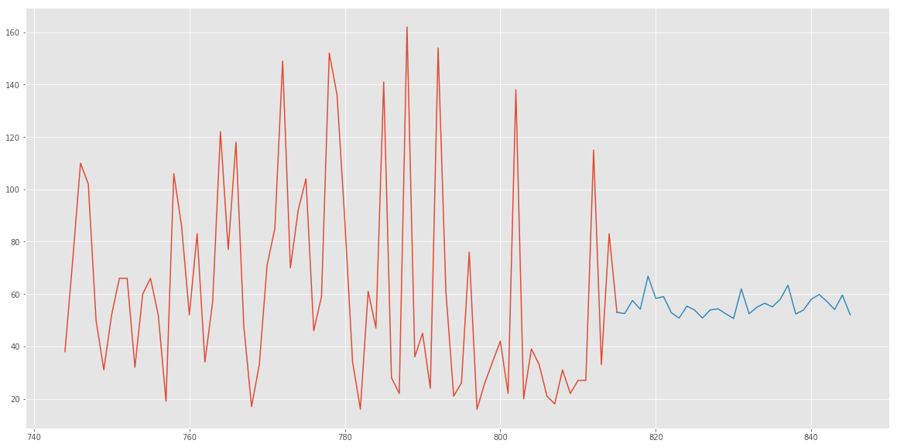
Linear dynamical system
32
FlightNum 75
FlightNum | RMSE | MAE | MAPE
75 | 34.449 | 30.609 | 0.944
321 | 13.886 | 10.837 | 0.274
FlightNum 321
Notes:
The main feature of the FEDOT framework is the complex management of interactions between various blocks of pipelines. First of all, this includes the stage of machine learning model design. FEDOT allows you to not just choose the best type of the model, but to create a complex (composite) model. It allows you to combine several models of different complexity, which helps you to achieve better modeling quality than when using any of these models separately.

Slide 37
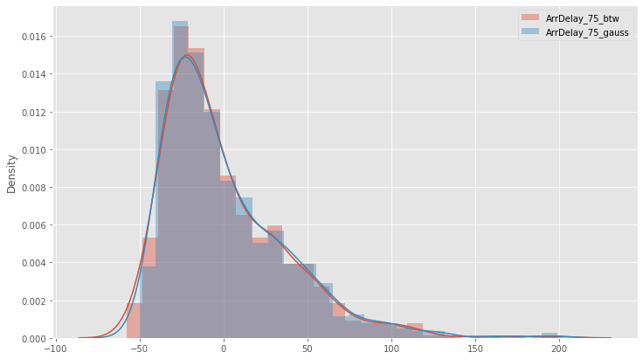
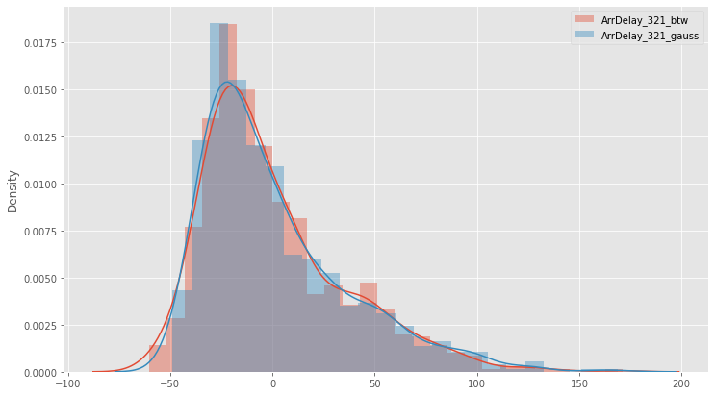
Residuals analysis
31
FlightNum 75
FlightNum 321
FlightNum | Filter | Mean | Variance
75 | Butterworth | -0.241 | 1323.763
 | Gauss | 1.0 | 1365.556
321 | Butterorth | 0.202 | 1227.552
 | Gauss | 1.113 | 1282.334
Notes:
and the same operation with Gaussian filters

Slide 38
Source code
30
GitHub link:
https://github.com/vvoronin96/MM_MDA

Slide 39

Thank you for attention!
Victor Voronin - vvoronin@niuitmo.ru
Andrey Antonov - andrevvantonovv@gmail.com
Daniil Nelybin – daniilnelybin@yandex.ru

